Slide 1
AI ENGINEERING
HAX Toolkit

Slide 2
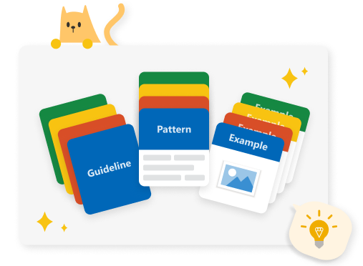
Microsoft HAX Toolkit

Slide 3
